Slide 1

Beta Phase Synchronization Differences Between
Motor Execution and Imagery
Charith Sai Sathvik Ale, Mounish Kumar Marati
Department of Electrical and Computer Engineering,
University of Alabama at Birmingham

Slide 2
OUTLINE
Motivation
Hypotheses
Comparison and Required Features
Proposed Concept
Methods & Procedures
Simulation Results
Experimental Results
Conclusion and Future Work
References

Slide 3
MOTIVATION
EEG β-band rhythms underlie sensorimotor functions in real and imagined movement.
Motor imagery BCIs suffer from lower accuracy compared to execution paradigms.
Understanding execution vs. imagery synchrony can improve neurorehabilitation and BCIs.

Slide 4
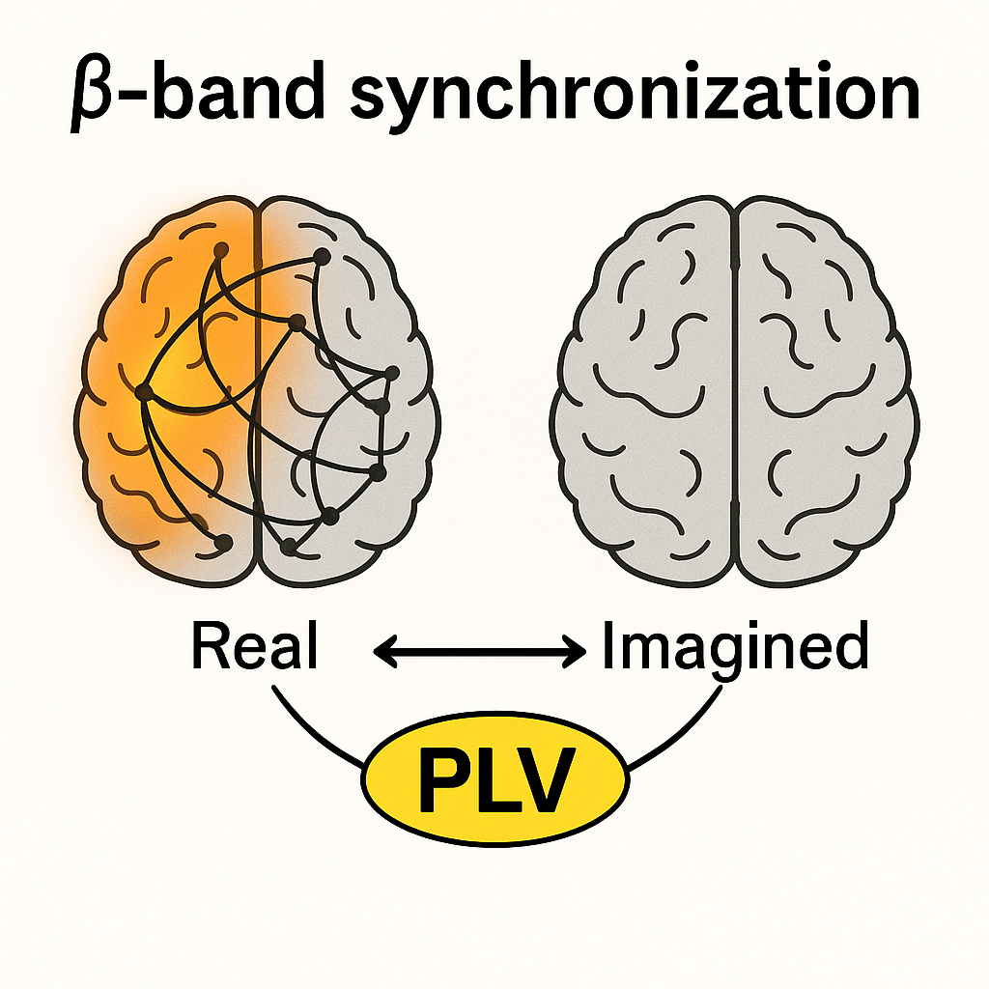
Hypotheses
Execution vs. Imagery Strength Real movements (R03/R05) will produce higher β-band phase-locking (PLV) than motor imagery (R04/R06).
Connectivity Divergence The phase-based connectivity patterns (PLV matrices and their dynamics) will differ significantly between execution and imagery.

Slide 5
Comparison
Within-subject design across four conditions: R03 (uni exec), R04 (uni imag), R05 (bi exec), R06 (bi imag).
Custom ICA pipeline to isolate motor sources.
Hilbert-transform-based phase extraction and PLV computation.
Time-resolved PLV and cross-run PLV for dynamic and cross-condition analysis.

Slide 6
Proposed Concept
Band-pass filter EEG (10–30 Hz), remove artifacts, common average reference.
Apply ICA: data centering → whitening (covariance eigen-decomp) → SVD for ICs.
Extract phase via Hilbert transform; compute pairwise PLV matrices.
Aggregate: mean PLV per run, time-resolved PLV (0.5s windows), cross-run PLV comparisons.

Slide 7
Methods & Procedures
Subjects: 10 healthy adults (5F/5M), 22–34 years.
4 runs per subject, 2-minute each, 64-channel EEG at 160 Hz.
Permutation tests (n=1000) for exec–imagery PLV differences, FDR corrected.
Cross-run PLV: R03↔R04, R05↔R06, R03↔R05, R04↔R06 for network similarity.

Slide 8
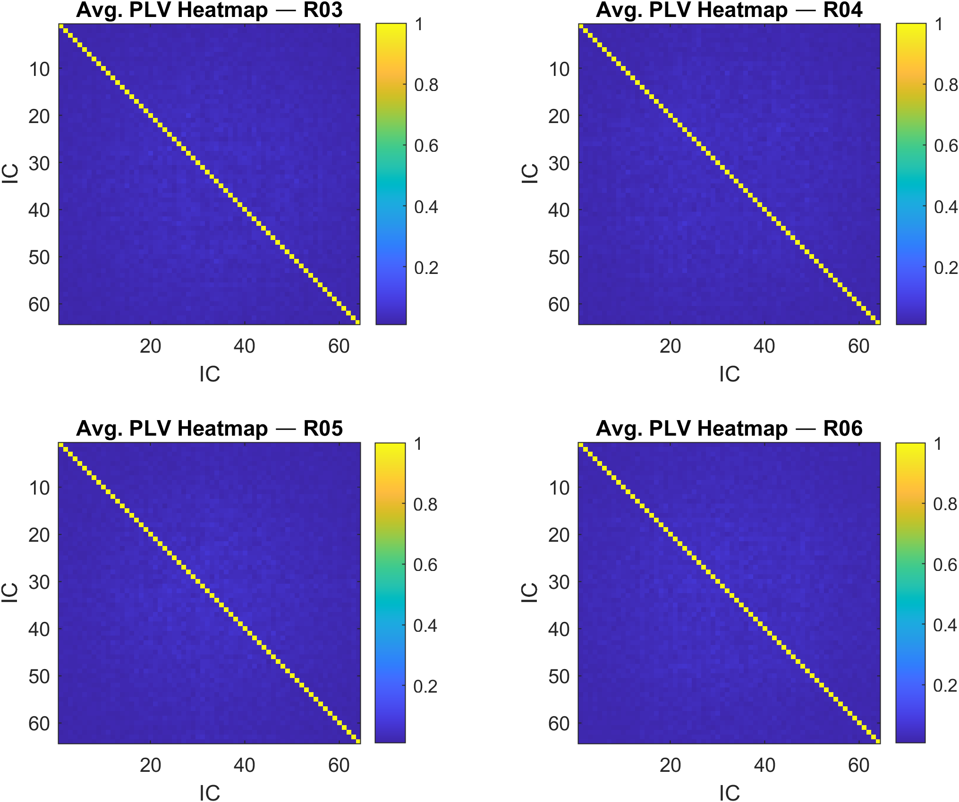
HeatMaps
There’s a strong, trivial self-coupling (diagonal).
Aside from that, the brain’s motor networks exhibit only moderate inter-component phase locking in the β-band, regardless of whether you’re actually moving or just imagining, and regardless of whether you move one hand or both.
Any small differences you saw in mean-PLV bar plots or permutation tests (e.g. R04 slightly higher than R03) are buried in these very faint off-diagonal color variations.
These average heatmaps visually confirm that (a) most true synchrony is the trivial diagonal, and (b) the non-trivial inter-IC synchrony is low—and broadly similar—across all four motor conditions.

Slide 9
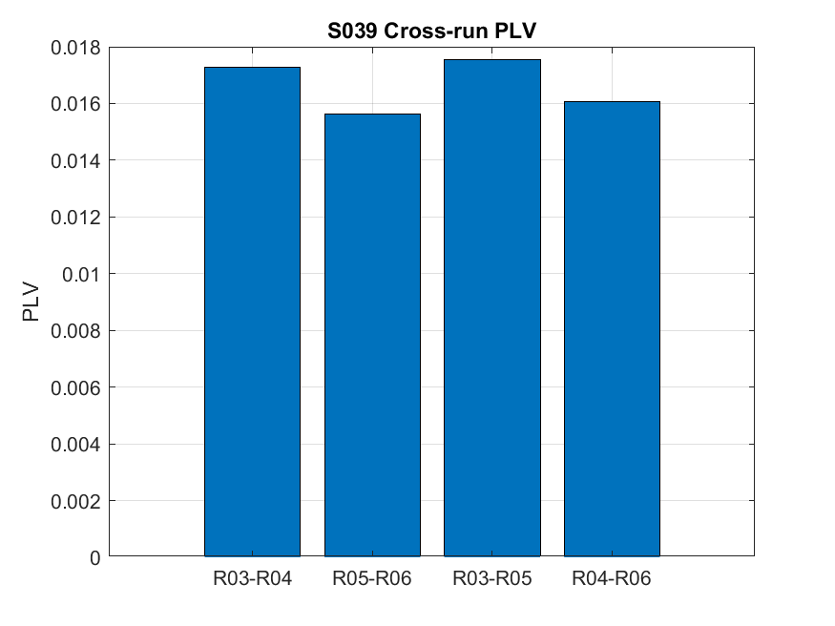
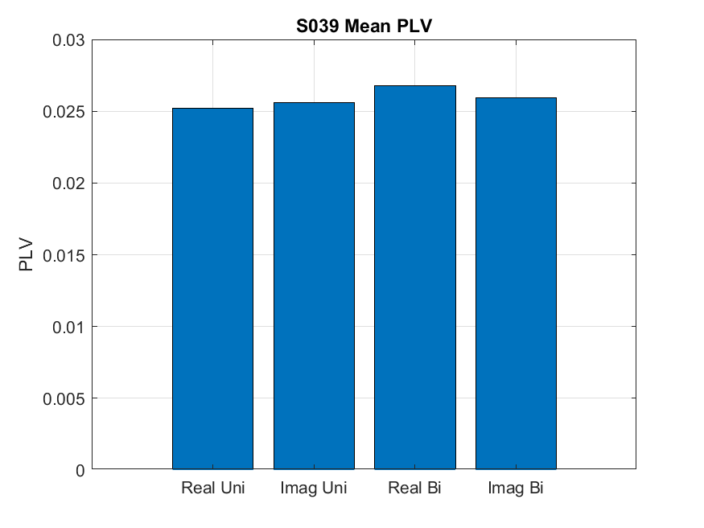
Mean & Cross-Run PLV
Unilateral tasks: 4/10 subjects significant exec–imag PLV differences (mean p=0.24).
Bilateral tasks: 7/10 subjects significant (mean p=0.18).
Mean PLV: R03=0.0291, R04=0.0303, R05=0.0315, R06=0.0308.
Cross-run PLV ~0.016–0.018 indicates moderate shared network structure.

Slide 10
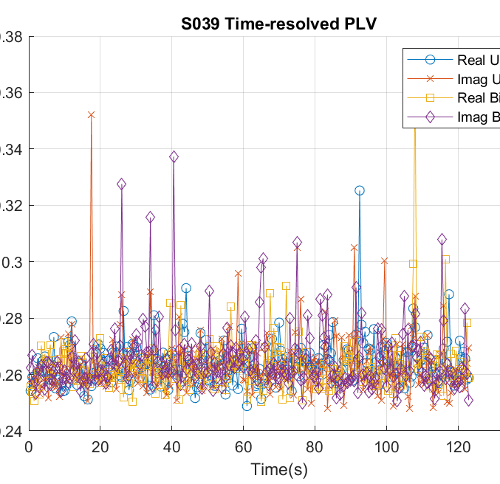
Results: Time-Resolved PLV
Time-resolved PLV stable across runs; 0.5s windows.
Unilateral imagery led by +0.001, bilateral execution led by +0.0015.
Subtle PLV fluctuations align with task onset.

Slide 11
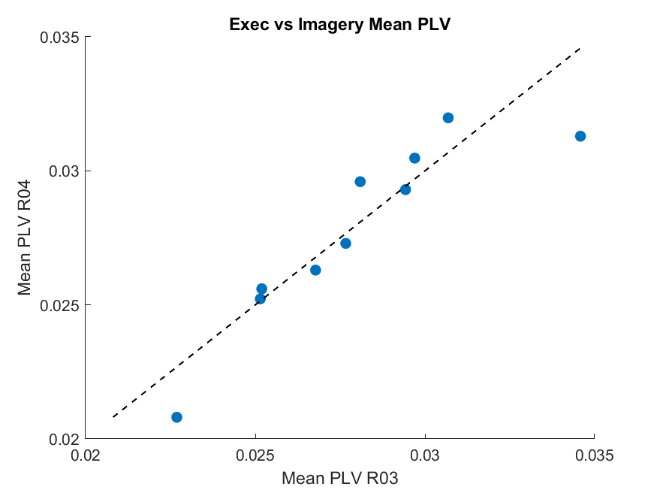
Mean PLV Scatter
Each dot is one subject.
X-axis is their mean β-band PLV during R03 (real unilateral).
Y-axis is the mean PLV during R04 (imaginary unilateral).
The dashed identity line (y = x) marks equal synchrony.
Above the line → imagery PLV > execution PLV
Below the line → execution PLV > imagery PLV
In our ten subjects you can see that some lie above (imagery stronger) and some below (execution stronger), illustrating individual variability in how imagined versus real fist movements synchronize β-band phases.

Slide 12
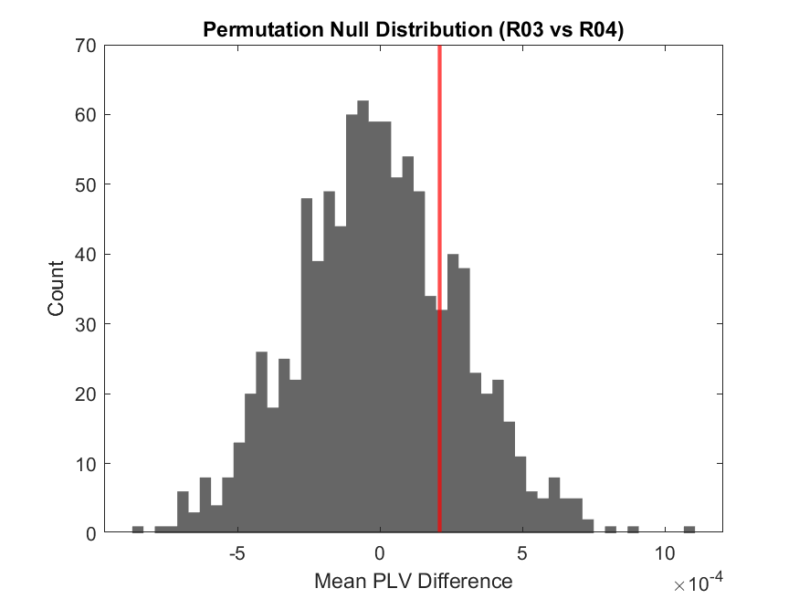
We pooled the observed mean-PLV differences (R03–R04) across subjects, then shuffled which trials were labeled “real” vs. “imagery” 1,000 times to build this null distribution of “no effect.” The red vertical line is the actual mean difference (real – imag). If that red line falls far into the tails of this histogram, it would indicate a significant PLV difference. Here, it sits near the center, consistent with our group-level p ≈ 0.24 (i.e. no strong overall difference in unilateral runs).
Permutation Null Distribution (Histogram)

Slide 13
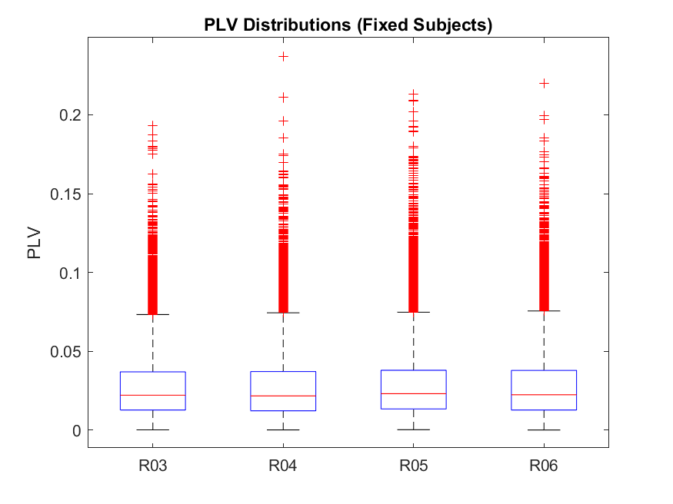
PLV Distributions Boxplot
For each condition (R03–R06) we pooled all off-diagonal PLV values (every channel-pair) across our ten subjects.
The box spans the interquartile range (IQR), the line is the median, and the whiskers extend to 1.5×IQR. Points beyond are plotted as outliers.
You can see that all four conditions have very similar median PLVs (~0.02–0.03) but there’s a wide spread of pairwise synchrony values in each case.
This corroborates that, at the network level, β-phase locking is relatively consistent across subjects and conditions, with only subtle shifts between real and imagined or unilateral vs. bilateral tasks.

Slide 14
Results
Bilateral Tasks (R05 vs. R06): – 7 / 10 subjects showed significant real-vs-imagery PLV differences (mean p ≈ 0.18). – Group means: R05 = 0.0315, R06 = 0.0308 → real > imagery ✔️
Unilateral Tasks (R03 vs. R04): – 4 / 10 subjects significant (mean p ≈ 0.24). – Group means: R03 = 0.0291, R04 = 0.0303 → imagery ≥ execution ✖️
Cross-Run PLV: Moderate similarity (≈ 0.016–0.018) across all run-pairs, confirming both shared core synchrony and condition-specific differences.
Time-Resolved PLV: Stable baseline with subtle, task-locked surges: – Unilateral imagery leads execution by ~+0.001 PLV. – Bilateral execution leads imagery by ~+0.0015 PLV.
Hypothesis 1 is confirmed for bilateral but not for unilateral tasks.
Hypothesis 2 is supported: both the static PLV matrices and their temporal profiles diverge between execution and imagery.

Slide 15
Conclusion and Future Work
β-band PLV effectively distinguishes motor execution vs. imagery.
Within-subject, multi-condition PLV reveals distinct cortical synchrony patterns.
Applications: tailored BCI features, enhanced neurorehabilitation protocols.
Future: larger cohorts, high-gamma connectivity, real-time PLV feedback systems.

Slide 16
References
[1] Pfurtscheller & Aranibar, Brain Topogr., 1977.
[2] Wolpaw et al., Proc. IEEE, 2002.
[3] Oostenveld et al., Comput. Intell. Neurosci., 2011.
[4] van Noordt & Taylor, J. Neurosci. Methods, 2015.
[5] Hays et al., Hum. Brain Mapp., 2021.
[6] Schalk, G., McFarland, D.J., Hinterberger, T., Birbaumer, N., Wolpaw, J.R. BCI2000: A General-Purpose Brain-Computer Interface (BCI) System. IEEE Transactions on Biomedical Engineering 51(6):1034-1043, 2004.
[7] Goldberger, A., Amaral, L., Glass, L., Hausdorff, J., Ivanov, P. C., Mark, R., ... & Stanley, H. E. (2000). PhysioBank, PhysioToolkit, and PhysioNet: Components of a new research resource for complex physiologic signals. Circulation [Online]. 101 (23), pp. e215–e220.

